Slide 1
Chat

Slide 2
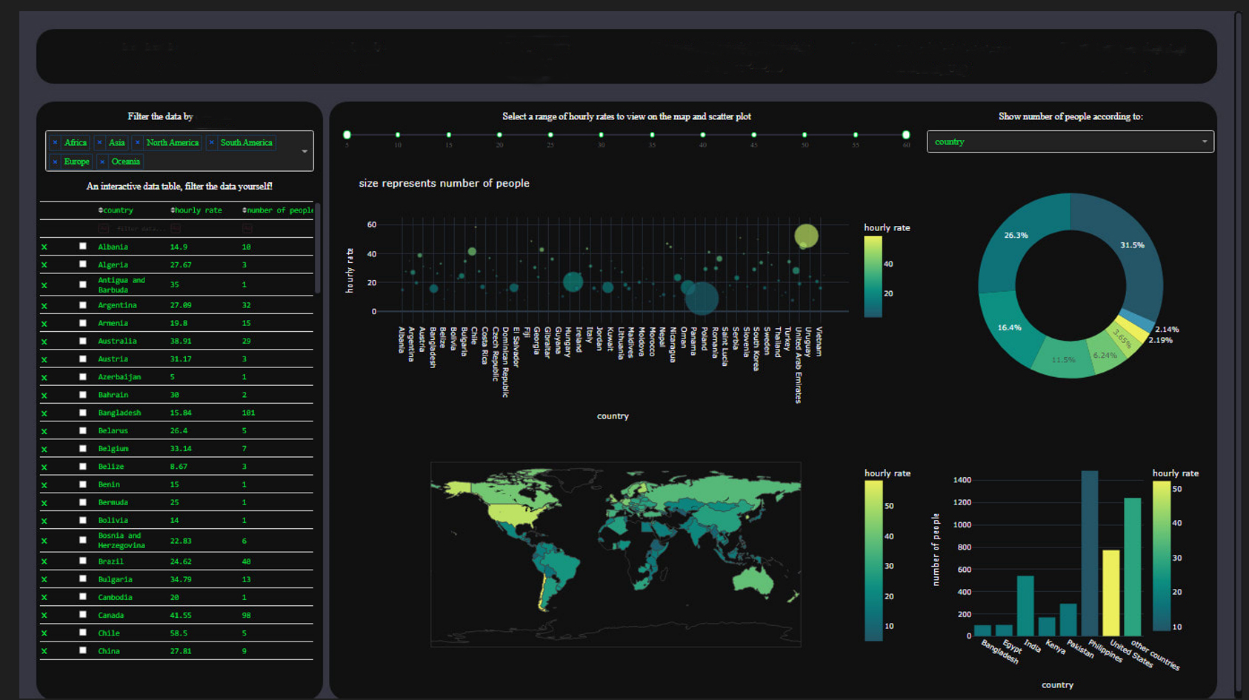
Ch
Total Population
541244
Total Male
25000
Total Female
25000
Total Communicants
25000
Total Non Communicants
25000

Slide 3
Filter By Presbyteries
Presbyteries here: Asante, Volta, Ga, Ga-west, Western, Head Office, Institutions
Sefwi, Kwahu, Akuapem, Sekyere, Upper, Northern, Central, Europe,
District, Total Population, Male, Female
List of all Districts

Slide 4
Presbyteries here: Asante, Volta, Ga, Ga-west,
Western, Head Office, Institutions
Sefwi, Kwahu, Akuapem, Sekyere, Upper, Northern,
Central, Europe,
Communicants & Non Communicants

Slide 5
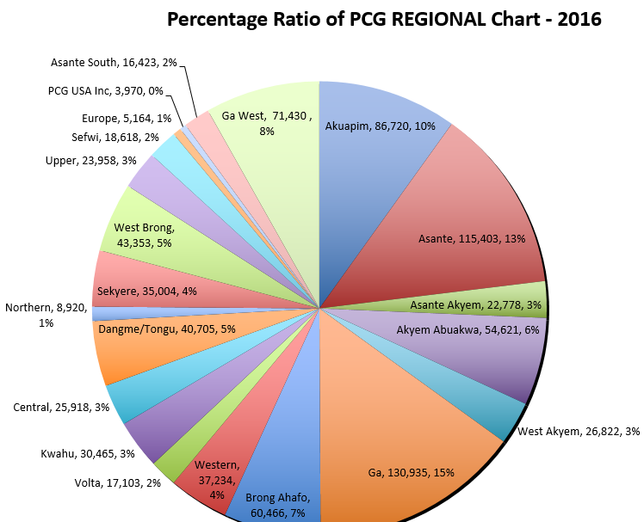
Refer to excel page title pcgstats2016
Select By Presbytery
Generational Groups Children Service
Junior Youth
Youth,
Young Adult’s Fellowship
Women Fellowship
Men Fellowship

Slide 6
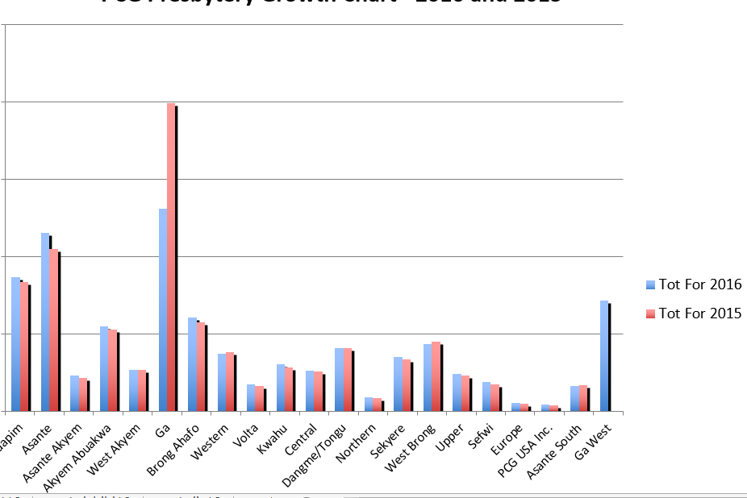
Reference Excel page no. pcggrowth 16&15

Slide 7
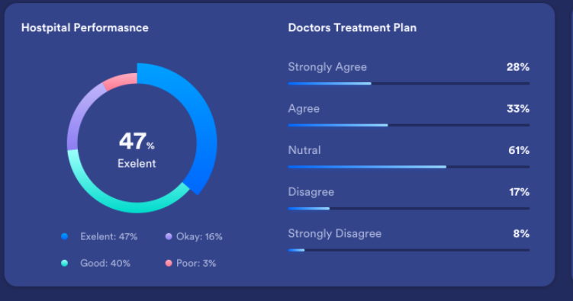
Reference Excel page no. pcgmem-agents16
Proportion of PCG Agents to Membership
Generational Groups

